Slide 1

Bayesian Uncertainty Quantification of Physical Models in Thermal-Hydraulics System Codes
Damar Wicaksono (Thesis Directors: Prof. A. Pautz & Mr. O. Zerkak)
PhD Defense, EPF Lausanne, 19.01.2018

Slide 2
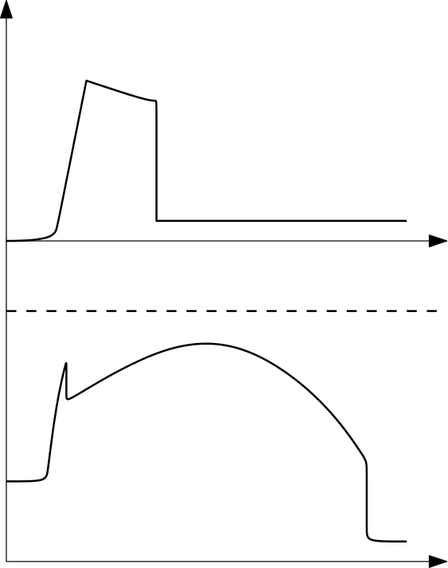
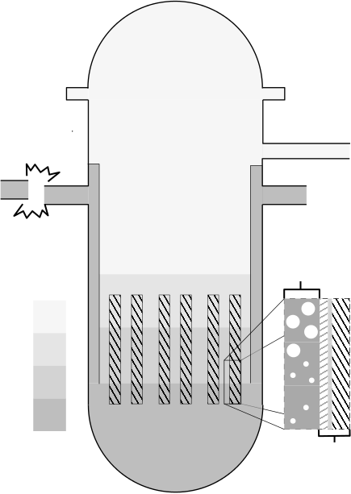
Safety Analysis of LWR under LBLOCA: Show max. clad temperature < safety limit
Reactor Pressure Vessel
ECC Mass Injection
Accumulator
Double-ended
Guillotine Break
Hot Leg
Low Pressure Injection
Cold Leg
Emergency Core Cooling
Safety Limit
Clad Temperature
Two-phase
hydraulics
Reactor Core
Gas Phase
Liquid Phase
Heat conduction through solids
Time
Notes:
To put things into context let’s revisit the role of simulation in the safety analysis of NPP, in this case under LBLOCA in perhaps rather simplistic view.
We make prediction whether some safety criteria is within the safety limit.
Simulation is based on the simulation of the two phase flow in the coolant circuit.

Slide 3
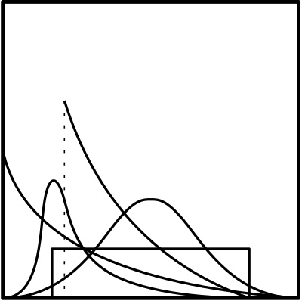
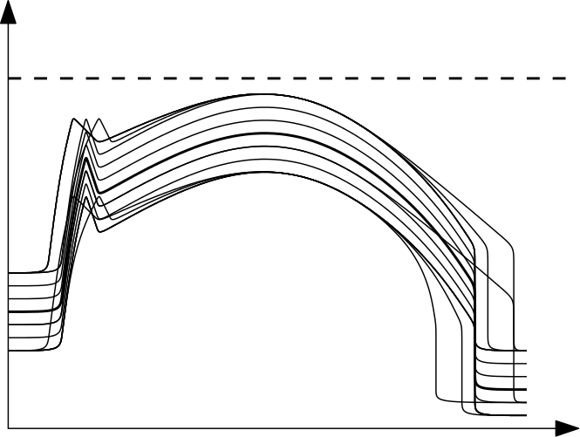
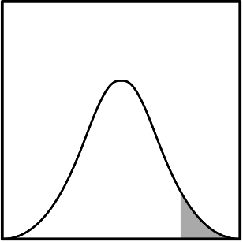

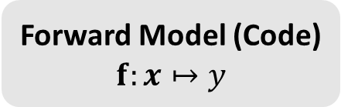
Forward Uncertainty Quantification: Uncertain Inputs $⇒$ Uncertain Outputs
Monte Carlo simulation (multiple code runs)
Forward Model (Code) $$f:x↦y$$
Statistical Analysis of ``Quantities of Interest’’
Uncertain Inputs
(random variables)
Safety Limit
e.g., PCT
Material properties
Initial conditions
Boundary conditions
Physical model parameters
Clad Temperature
Uncertain Outputs
Decision Making
Safe/Fail, Accept/Reject, etc.
Notes:
Give the general impression first from left to right
And the main ingredient of this analysis is the uncertain inputs

Slide 4
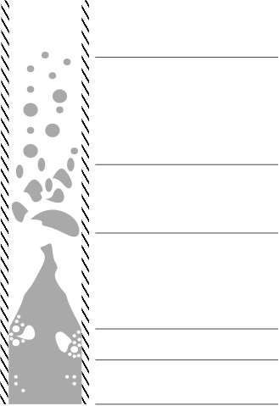
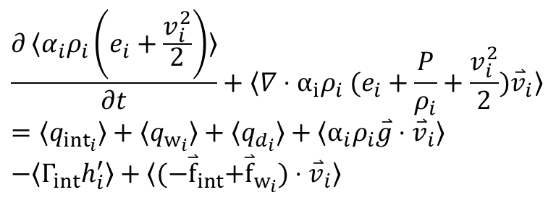
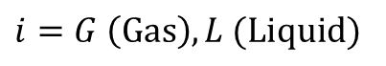
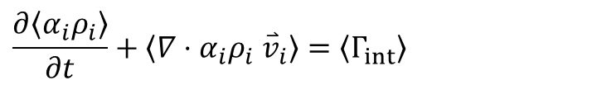
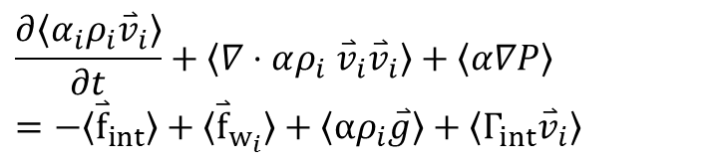
Physical Model Parameters: post-Critical Heat Flux (CHF) Flow Regimes
Mass
Closure Laws
pre-CHF
(Steam Convection)
Parametric
models
$$\frac{∂〈α_{i}ρ_{i}〉}{∂t}+〈∇⋅α_{i}ρ_{i} {\overset{⃑}{v}}_{i}〉=〈Γ_{int}〉$$
Dispersed Flow Film Boiling (DFFB)
Momentum
$$\frac{∂〈α_{i}ρ_{i}{\overset{⃑}{v}}_{i}〉}{∂t}+〈∇⋅αρ_{i} {\overset{⃑}{v}}_{i}{\overset{⃑}{v}}_{i}〉+〈α∇P〉 \\ =−〈{\overset{⃑}{f}}_{int}〉+〈{\overset{⃑}{f}}_{w_{i}}〉+〈αρ_{i}\overset{⃑}{g}〉+〈Γ_{int}{\overset{⃑}{v}}_{i}〉$$
Interpolatory (Inverted Slug)
Energy
$$\frac{∂〈α_{i}ρ_{i}\left(e_{i}+\frac{v_{i}^{2}}{2}\right)〉}{∂t}+〈∇⋅α_{i}ρ_{i} (e_{i}+\frac{P}{ρ_{i}}+{\frac{v_{i}^{2}}{2})\overset{⃑}{v}}_{i}〉 \\ =〈q_{{int}_{i}}〉+〈q_{w_{i}}〉+〈q_{d_{i}}〉+〈α_{i}ρ_{i}\overset{⃑}{g}⋅{\overset{⃑}{v}}_{i}〉 \\ −〈Γ_{int}h_{i}^{′}〉+〈{(−\overset{⃑}{f}}_{int}+{\overset{⃑}{f}}_{w_{i}})⋅{\overset{⃑}{v}}_{i}〉$$
Inverted Annular Film Boiling (IAFB)
Transition Boiling
pre-CHF
(Nucleate Boiling)
$$i=G \left(Gas\right), L (Liquid)$$
Notes:
What are these physical model parameters?
Simulation of two phase flows are based on solving a set of balance equation.
Closure laws describe the interaction between phases in each distinct **pre-determined** flow regime
Take for example the phenomenological models that describe two phase flow during a reflood of a dry channel
Here is system code TRACE

Slide 5
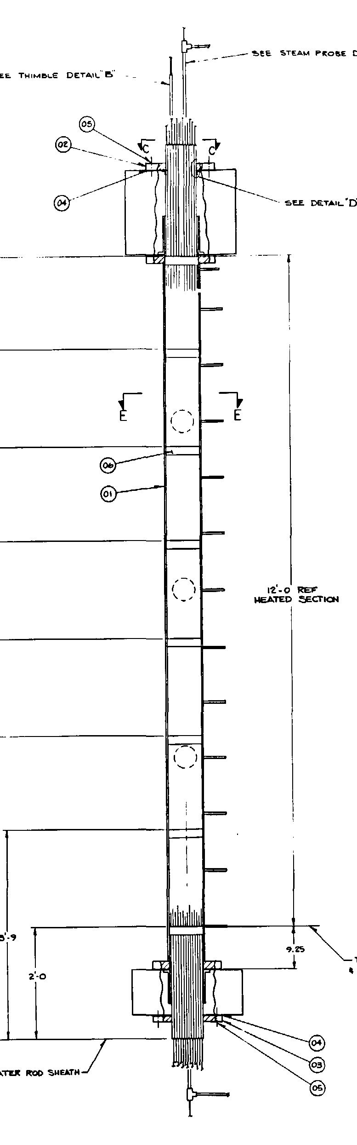
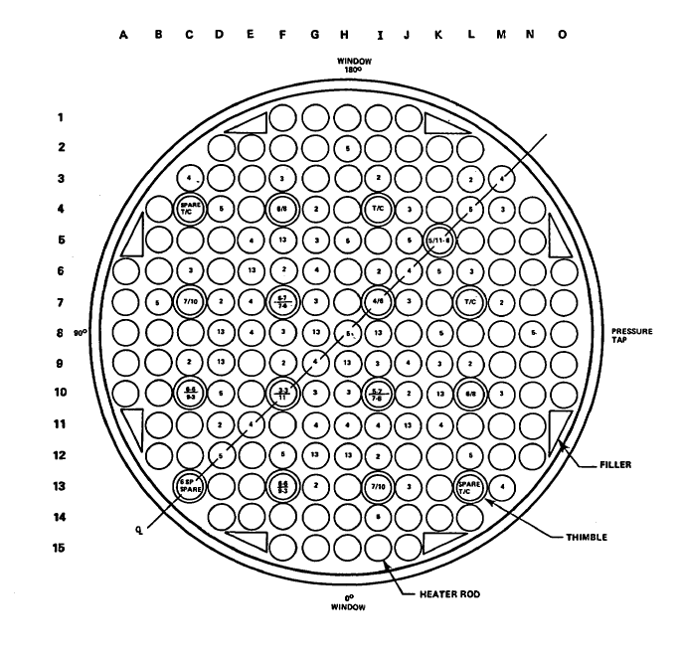
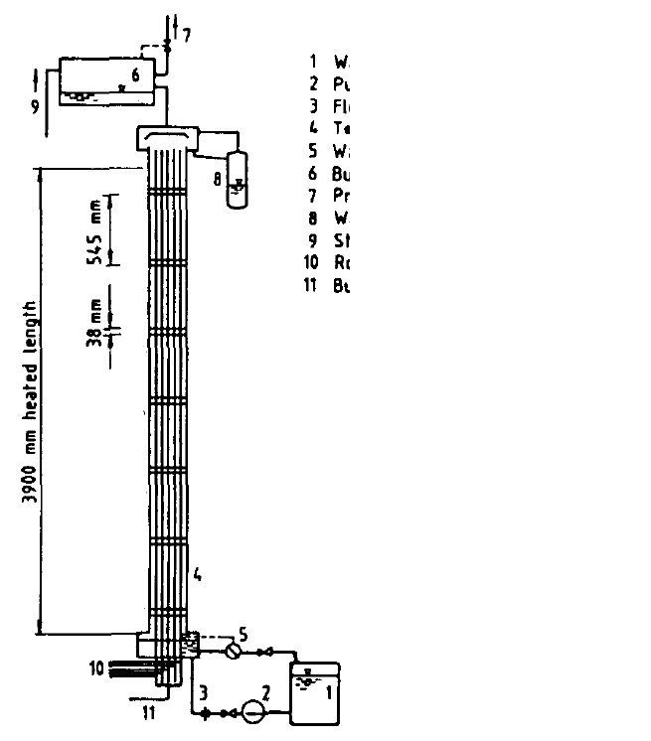
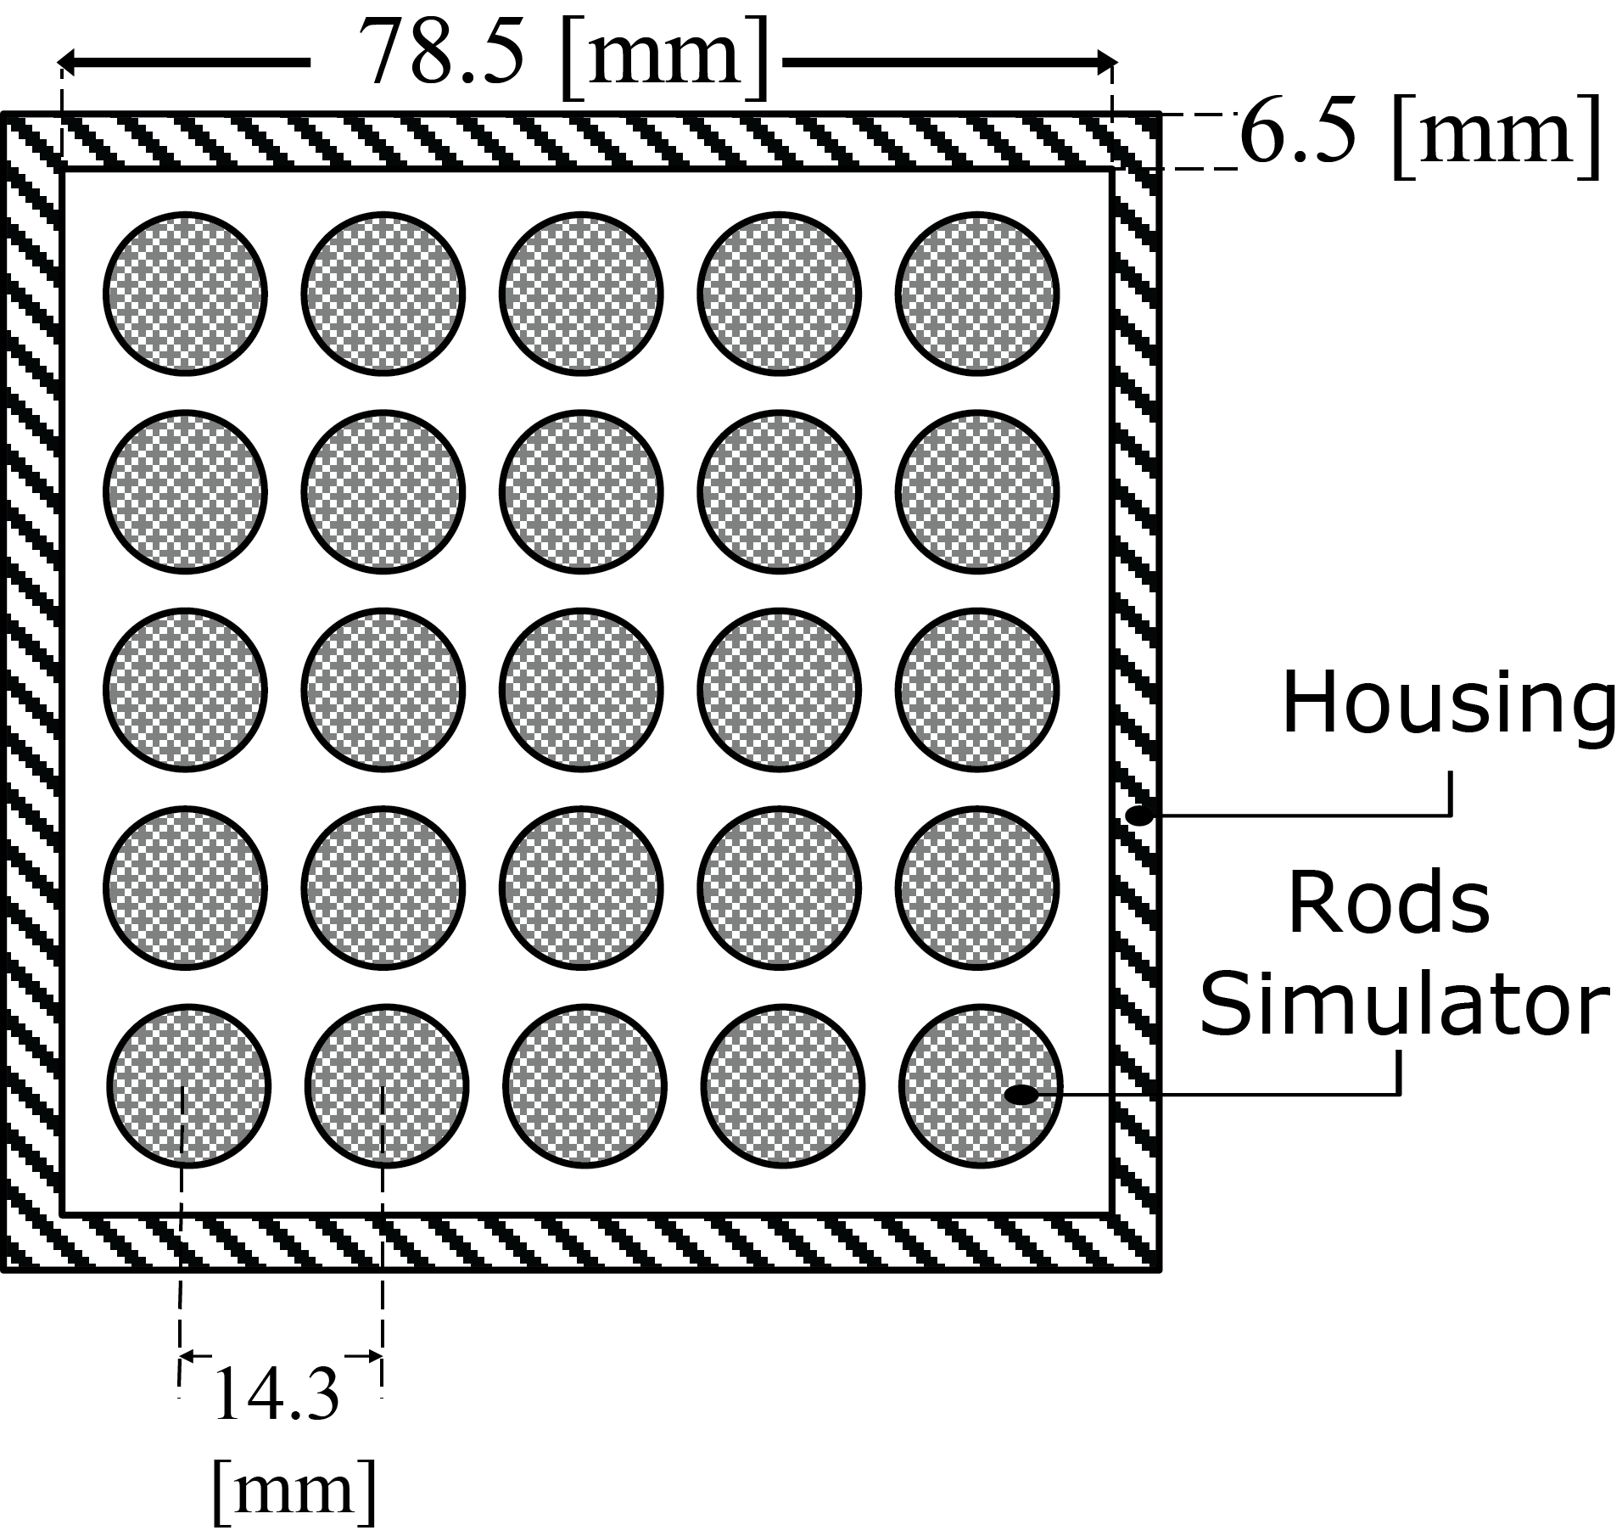
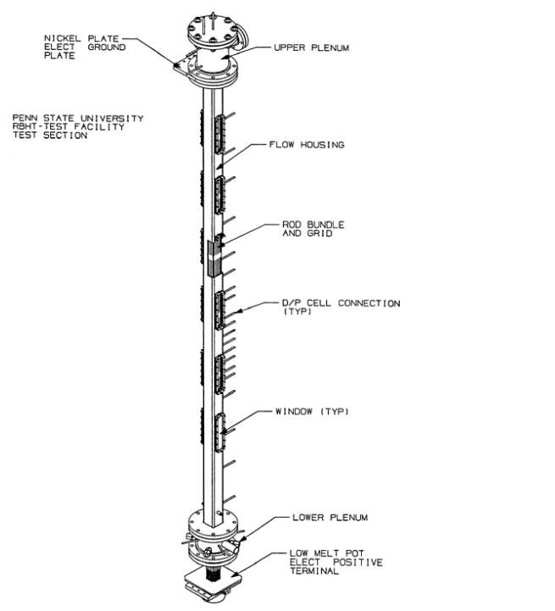
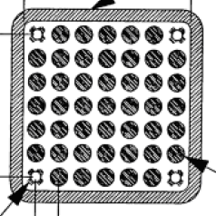
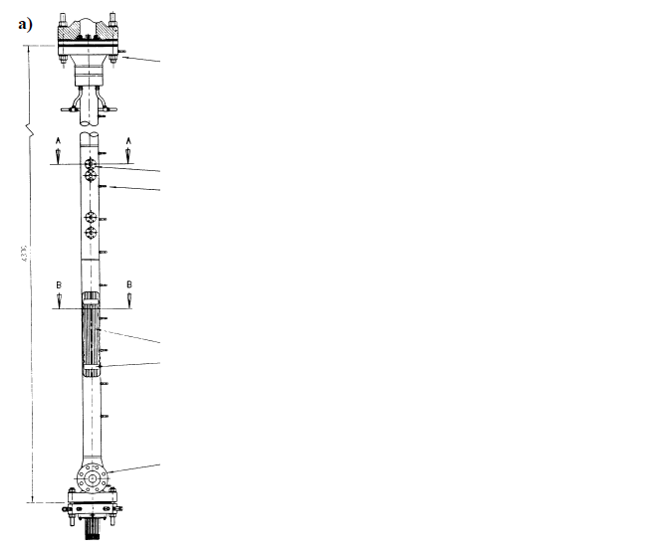
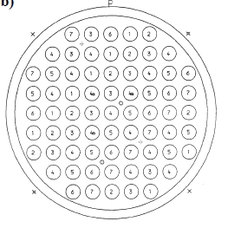
Uncertainty in Physical Model Parameters
Excerpt from the TRACE Code Theory Manual:
“…the approximate value of the coefficient in Eq. (4-119) was determined from data comparisons with FLECHT-SEASET high flooding rate reflood data…” (pp. 164)
“In TRACE, the above interfacial drag coefficient has been reduced by a factor of ¾ to better match FLECHT-SEASET high flooding rate reflood data, so…” (pp. 166)
FLECHT-SEASET
Westinghouse, USA
What if the calibration was done on other, similar, separate effect test facilities (SETFs)?
FEBA
KIT, Germany
RBHT
PSU, USA
ACHILLES
Winfrith, UK
Notes:
Where is this uncertainty coming from
Note that the parameters become somehow an adjustment factor
We derive the uncertainty associated with it through expert judgment

Slide 6
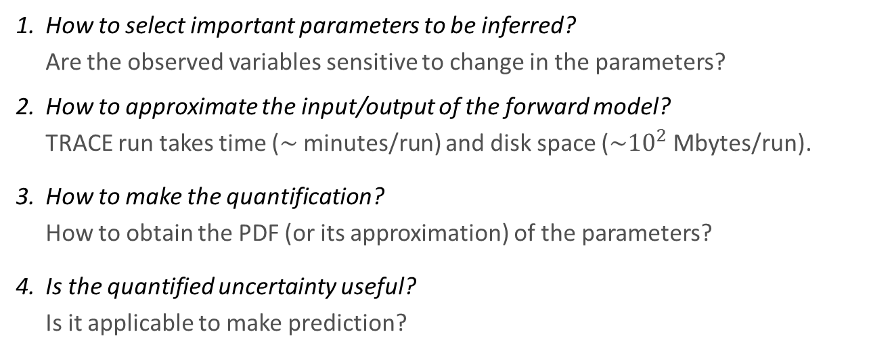
Research Objectives
Given experimental data from a Separate Effect Test Facility (SETF), develop a methodology to:
quantify the uncertainty of physical model parameters in a TH System Code
to be sampled from and propagated within statistical uncertainty analysis framework.
In an illustrative example this entails four main questions:
How to select important parameters to be inferred? Are the observed variables sensitive to change in the parameters?
How to approximate the input/output of the forward model? TRACE run takes time ($\sim$minutes/run) and disk space ($\sim {10}^{2}$Mbytes/run).
How to make the quantification? How to obtain the PDF (or its approximation) of the parameters?
Is the quantified uncertainty useful? Is it applicable to make prediction?

Slide 7
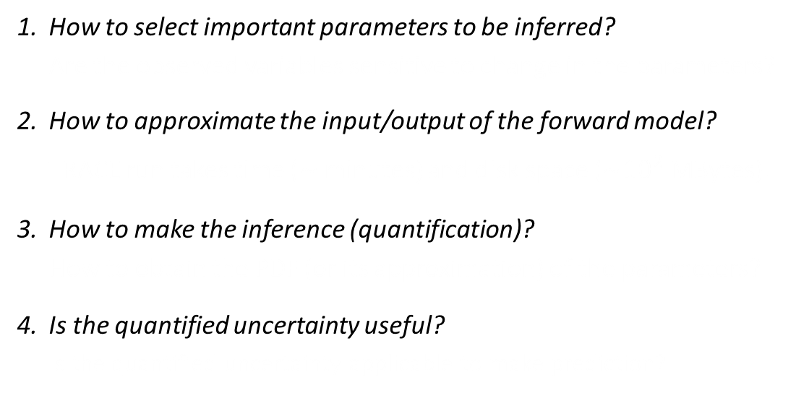
Scope of Research: Statistical Framework
Methods are non-intrusive
Methods require less assumptions about the underlying model
Ultimate results conform with probabilistic framework for UQ
Methods tend to be expensive
(require numerous code runs)
How to select important parameters to be inferred? Are the observed variables sensitive to change in the parameters?
How to approximate the input/output of the forward model? TRACE run takes time ($\sim$minutes) and disk space ($\sim {10}^{2}$MBytes).
How to make the inference (quantification)? How to obtain the PDF (or its approximation) of the parameters?
Is the quantified uncertainty useful? Is the quantified uncertainty applicable to make prediction?
Global Sensitivity Analysis
Gaussian Process Metamodeling
Bayesian Calibration
Uncertainty Propagation
Notes:
To answer those questions, we adapt and implement statistical methodologies derived from applied statistics especially related to the design and analysis of computer experiments.
And we don’t develop codes, it is worthwhile to develop methods that is applied outside the code implementation.
Don’t list the tools, state that it will serve as an outline of the presentation.

Slide 8
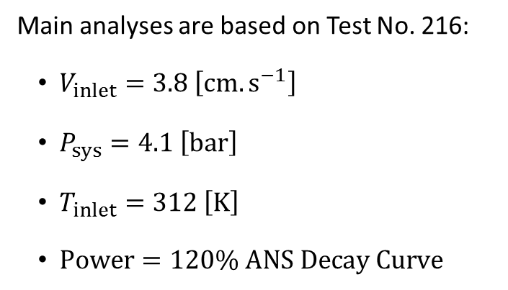
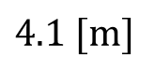
Scope of Research: FEBA Separate Effect Test Facility (SETF)
FEBA Reflood Tests were conducted at Kfz Karlsruhe (KIT) during 1980s for investigating bottom reflood using rod simulators (NiCr)
Main analyses are based on Test No. 216:
$V_{inlet}=3.8 \left[cm.s^{−1}\right]$
$P_{sys}=4.1 \left[bar\right]$
$T_{inlet}=312 \left[K\right]$
$Power=120\% ANS Decay Curve$
$$4.1 [m]$$
Three types of measurements were taken:
Clad temperature (8 axial locations)
Pressure drop (4 axial segments)
Liquid carryover

Slide 9
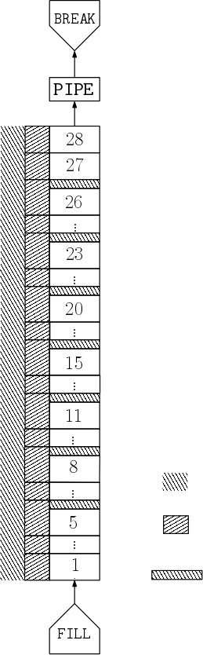
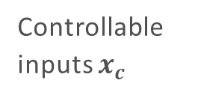
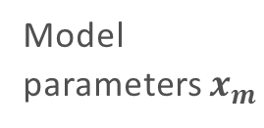
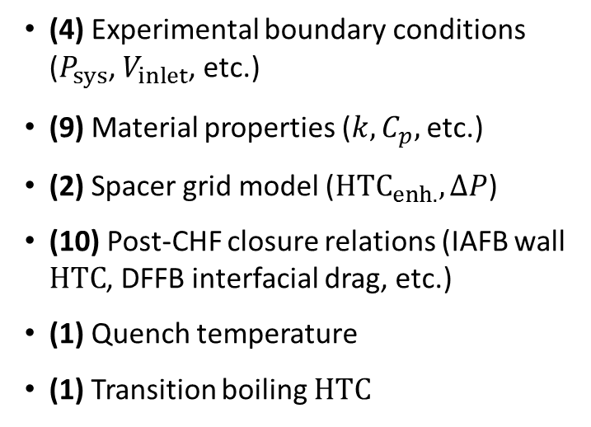
Scope of Research: TRACE Model of FEBA SETF
Backpressure
27 Parameters are required to specify the model:
(4) Experimental boundary conditions ($P_{sys}$, $V_{inlet}$, etc.)
(9) Material properties ($k,C_{p},$etc.)
(2) Spacer grid model ($HTC_{enh.},ΔP$)
(10) Post-CHF closure relations (IAFB wall $HTC$, DFFB interfacial drag, etc.)
(1) Quench temperature
(1) Transition boiling $HTC$
Upper plenum
Controllable inputs $x_{c}$
Model
parameters $x_{m}$
Powered Heater Rods
With flat independent uncertainties, either in linear or log scales
Housing/Enclosure
Spacer grid
Inlet flow
Notes:
The method is adapted and demonstrated directly to solve this problem.
The problem is used in the OECD/NEA PREMIUM Benchmark

Slide 10
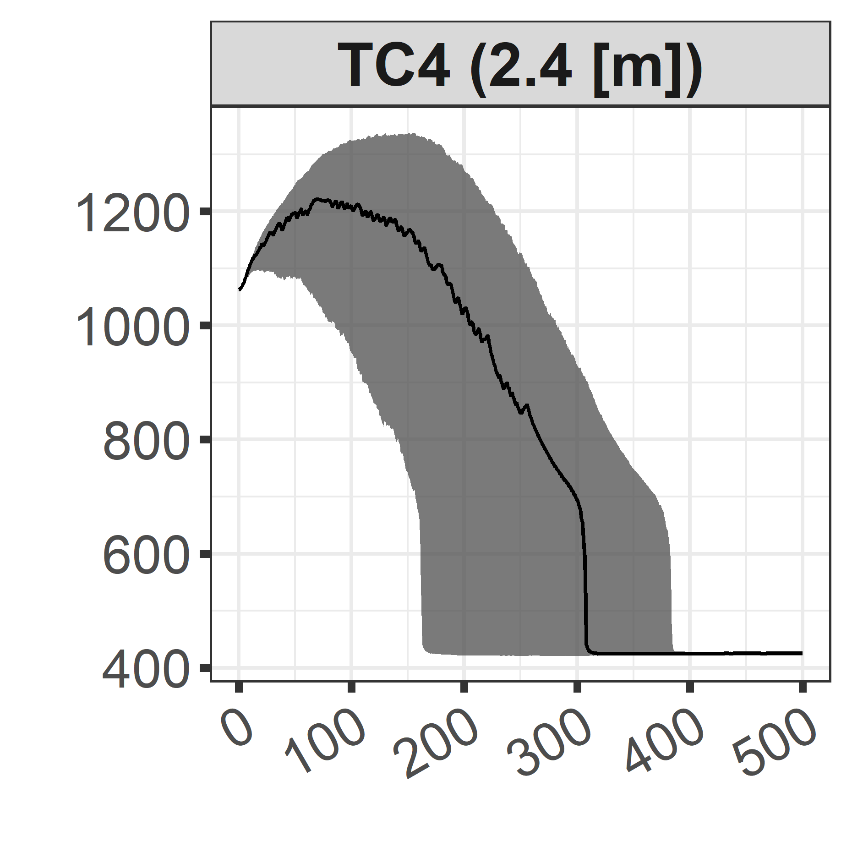
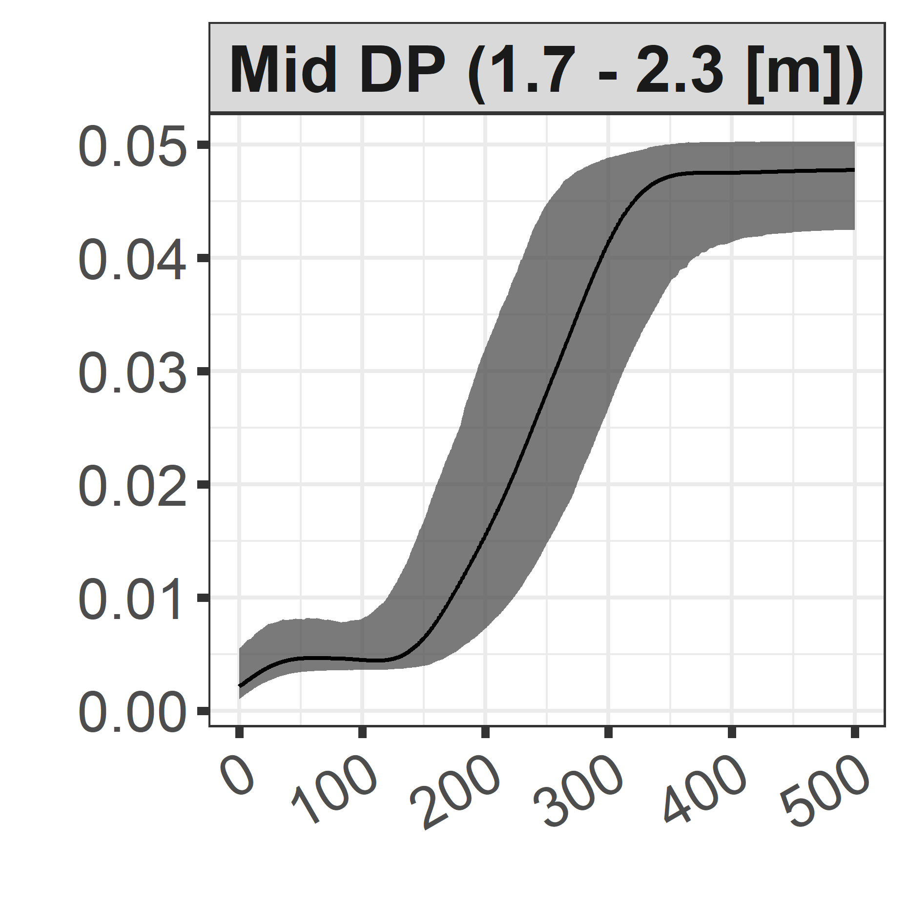
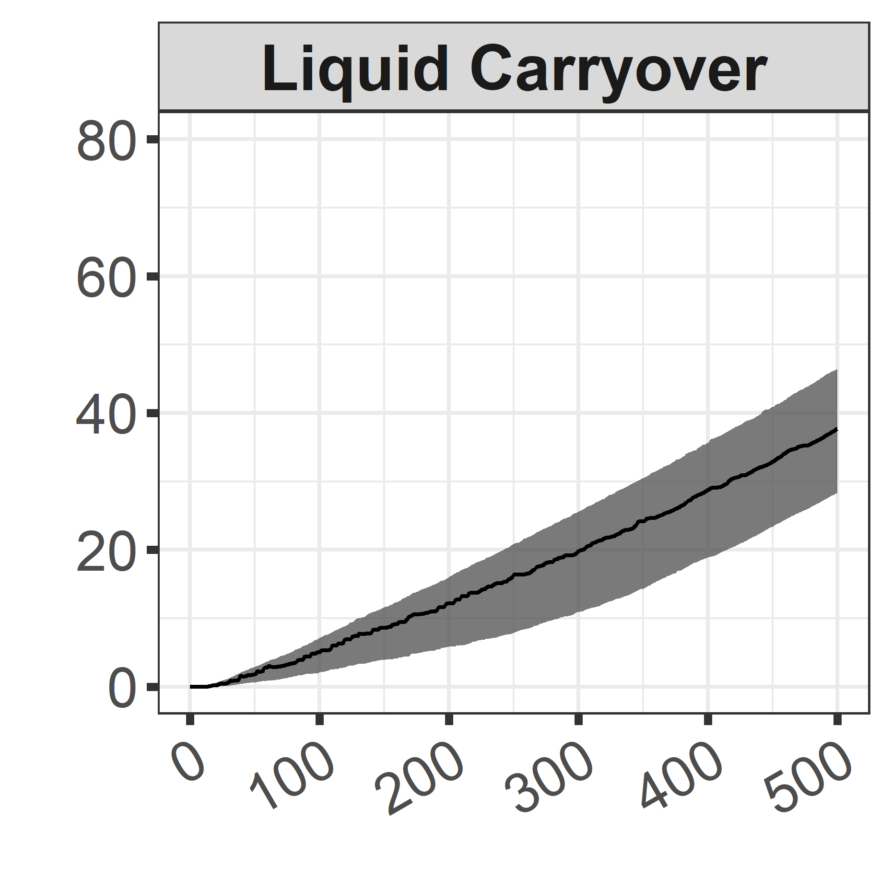
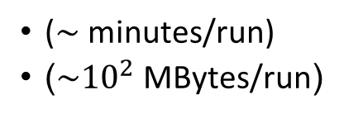
Statistical Framework (1/4): Global Sensitivity Analysis for Screening
How to select important parameters to be inferred?
Global Sensitivity Analysis
27 initial parameters
Identify the least influential parameters, and exclude them
How to approximate the input/output of the forward model?
Propagation based on 1’000 samples
Gaussian Process Metamodeling
($\sim$minutes/run)
($\sim {10}^{2}$MBytes/run)
How to make the inference (quantification)?
Clad Temperature [K]
Bayesian Calibration
Pressure Drop [bar]
Liquid Carryover [kg]
Is the quantified uncertainty useful?
Uncertainty Propagation
Time [s]
Nominal parameter
Notes:
Uncertainty propagation using prior pdfs and 1’000 samples. Bands are constructed based on the 95% probability (2.5th – 97.5th percentile).

Slide 11
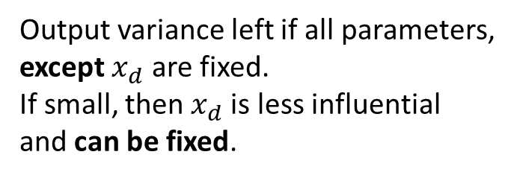

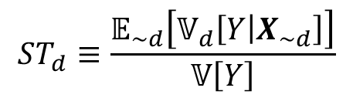
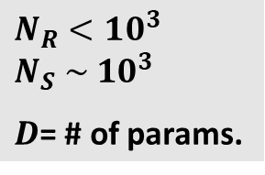
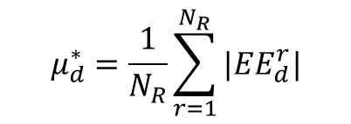
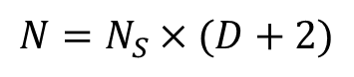
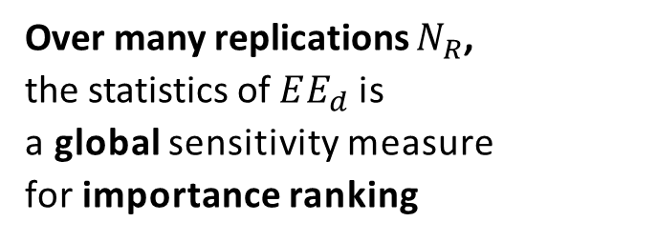
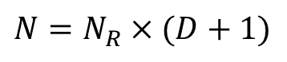
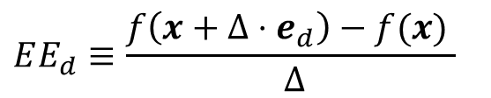

Global Sensitivity Analysis for Screening: The Morris Screening and Sobol’ Total-Effect
Elementary effect $EE_{d}:$
Sobol’ total-effect index for $x_{d}$:
Perturbation of one parameter at a time
$$EE_{d}≡\frac{f\left(x+Δ⋅e_{d}\right)−f(x) }{ Δ}$$
$$ST_{d}≡\frac{𝔼_{\sim d}\left[𝕍_{d}\left[Y | X_{\sim d}\right]\right]}{𝕍\left[Y\right]}$$
Grid size
Over many replications $N_{R}$, the statistics of $EE_{d}$is a global sensitivity measure for importance ranking
Output variance left if all parameters, except $x_{d}$ are fixed. If small, then $x_{d}$is less influential and can be fixed.
Mean of absolute value
$$μ_{d}^{∗}=\frac{1}{N_{R}}\sum_{r=1}^{N_{R}}{{|EE}_{d}^{r}|}$$
Computed by Monte Carlo estimation
Computation cost (code runs)
$$N_{R}<10^{3} \\ N_{S} \sim 10^{3}$$ $D$= # of params.
$$N=N_{R}×(D+1)$$
$$N=N_{S}×(D+2)$$
Notes:
Formula
Meaning
Computation notes
Why we consider the two

Slide 12
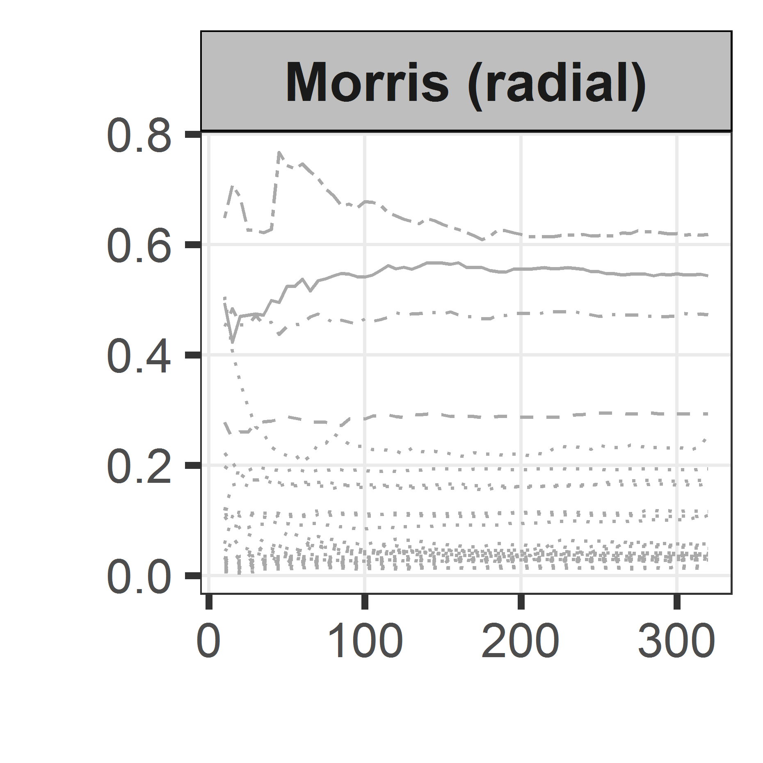
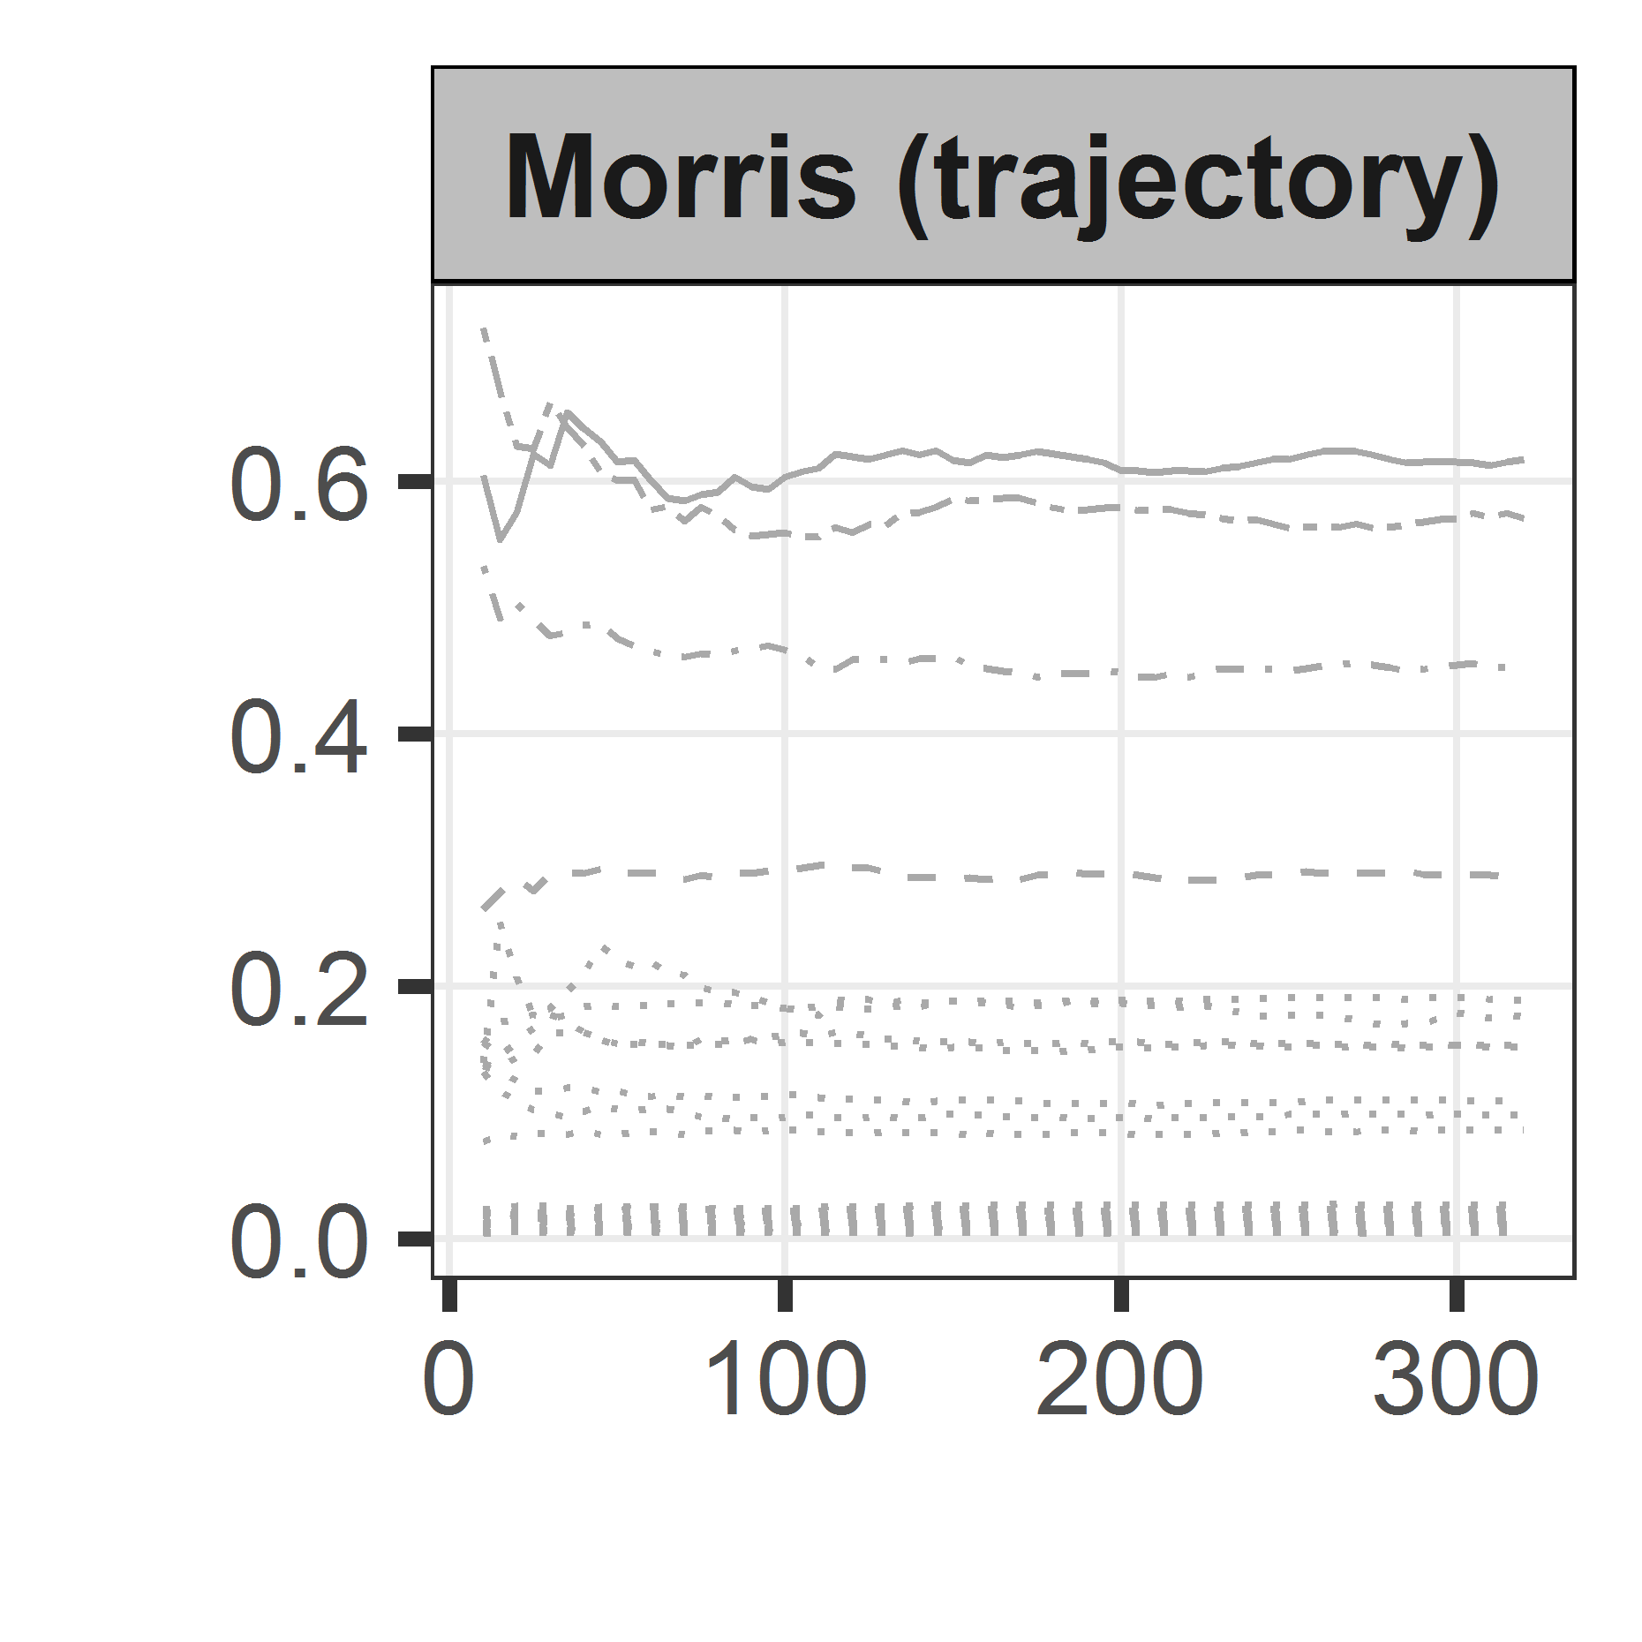
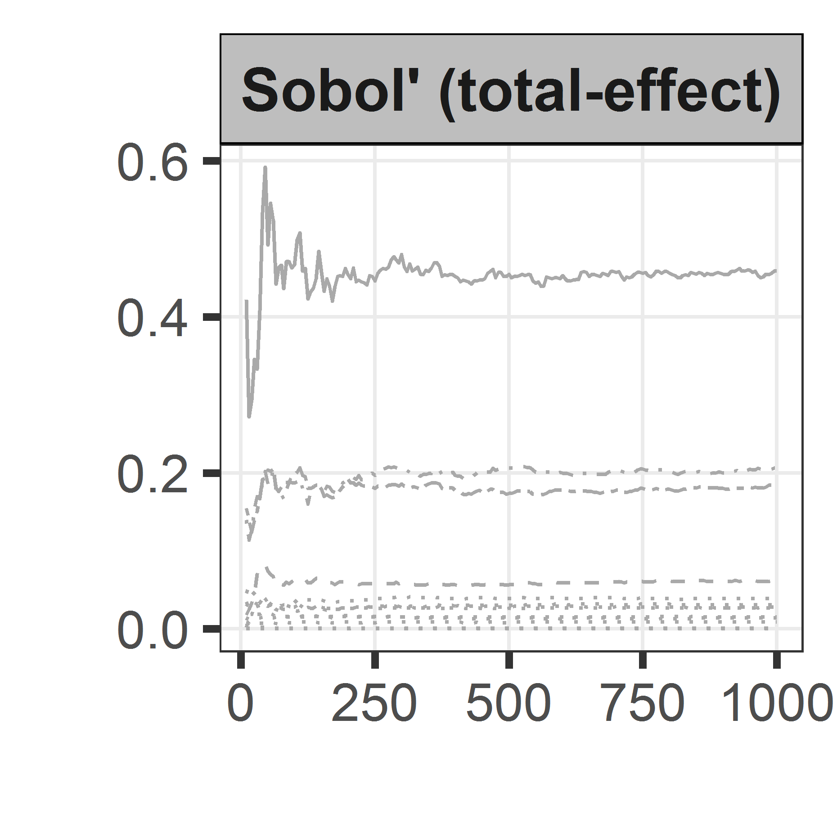
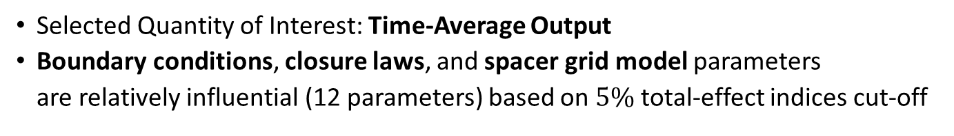
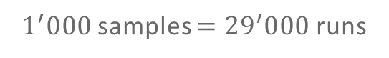

Global Sensitivity Analysis for Screening: Comparison of Methods
Selected Quantity of Interest: Time-Average Output
Boundary conditions, closure laws, and spacer grid model parameters are relatively influential (12 parameters) based on $5\%$ total-effect indices cut-off
$320$ replications $=8^{′}960$runs
$1^{′}000$ samples $={29}^{′}000$runs
Sensitivity Measure
Results on TC4 output
Number of Replications / Samples
Notes:
The three screening methods give (more/less) consistent ranking
Morris is faster, but Sobol’ allows to have a quantitative criteria
Quite a lot of run required but maybe you don’t actually need to run all the way through

Slide 13
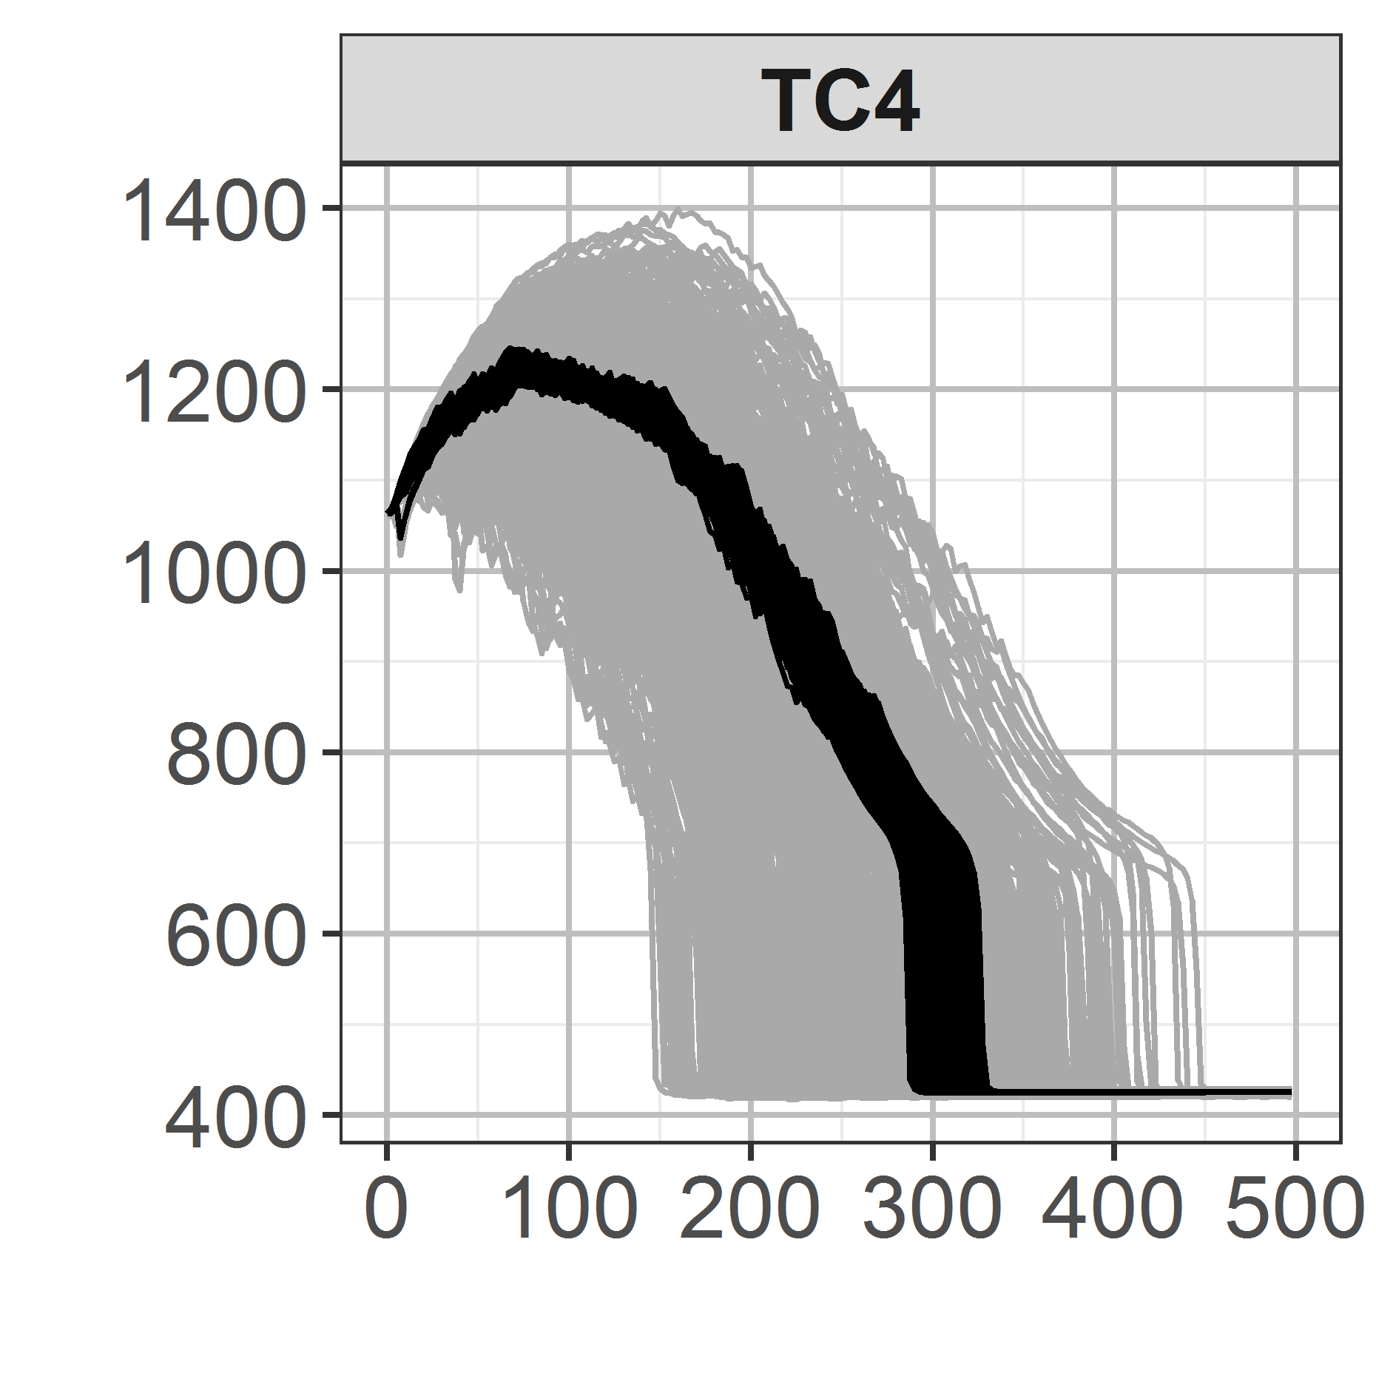
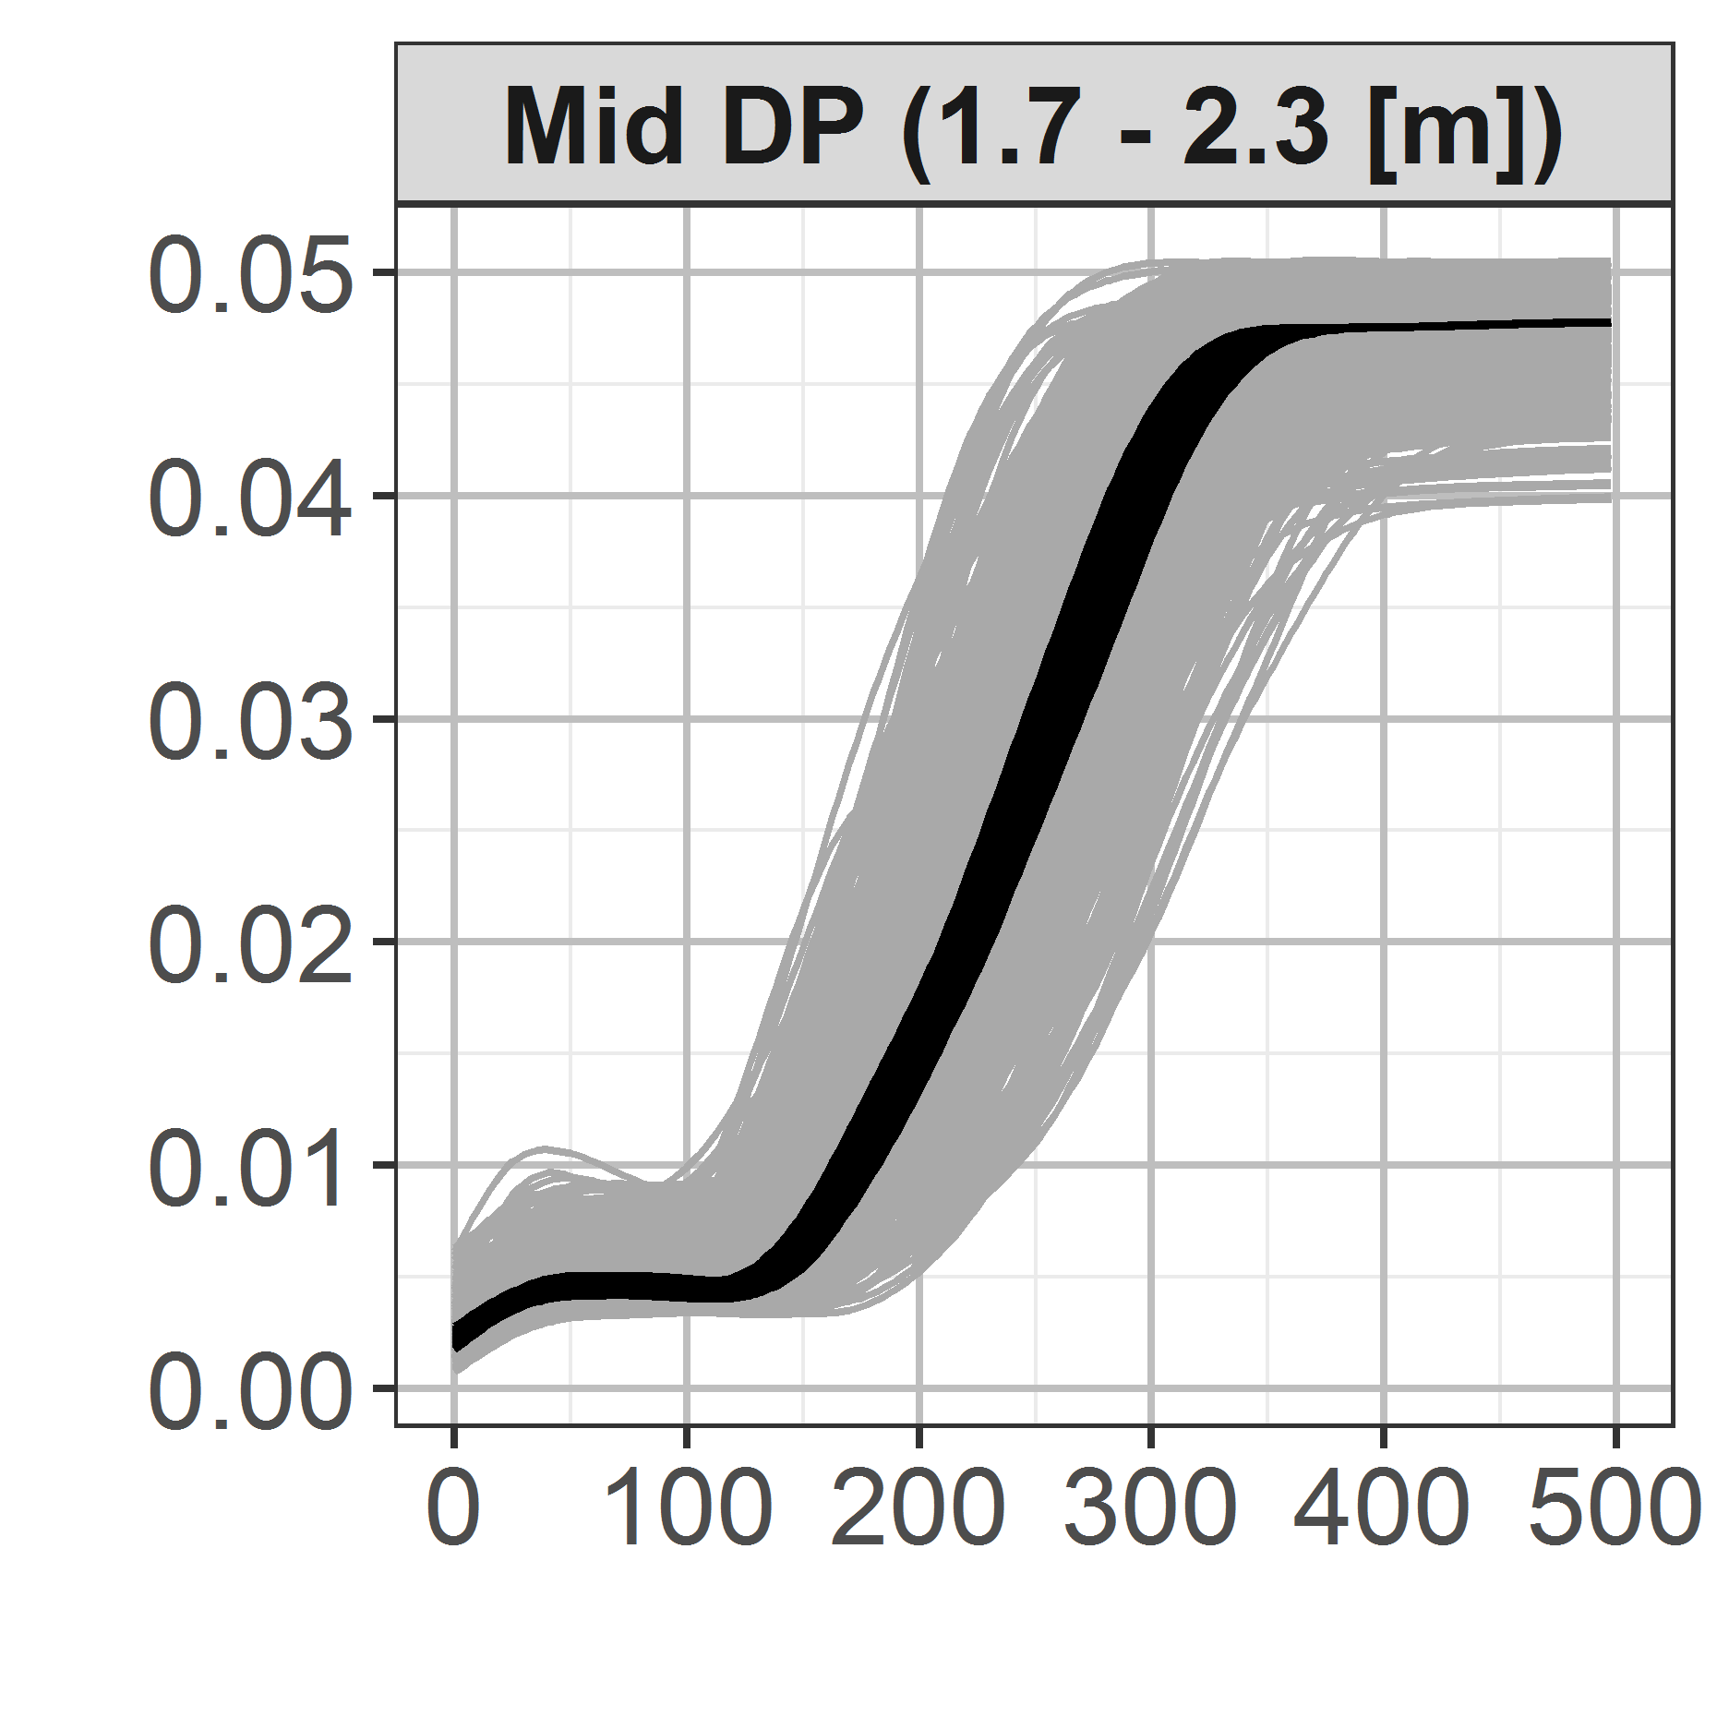
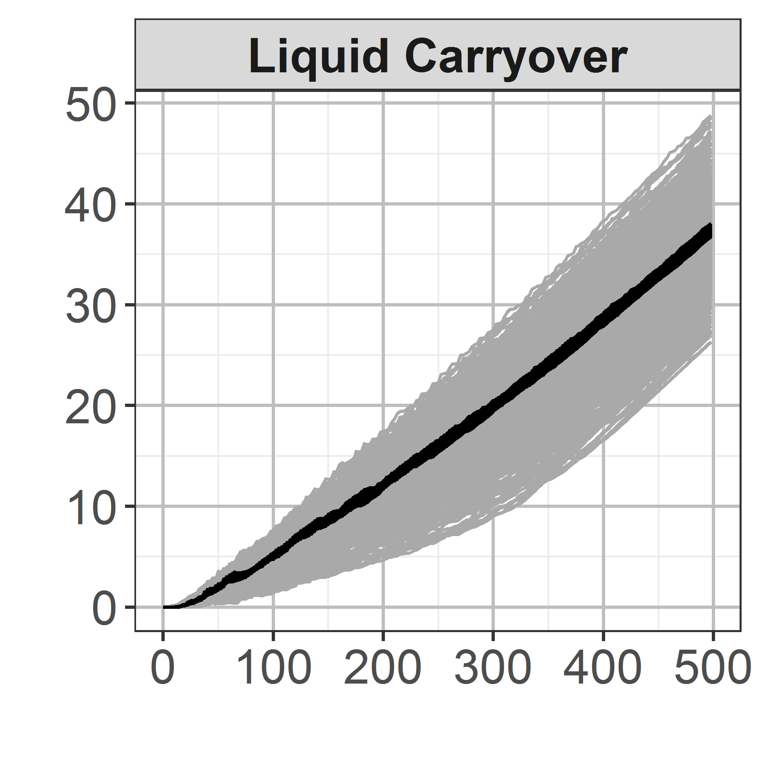
Uncertainty Propagation using Influential vs. Non-Influential Parameters
Uncertainty propagation using 2 parameter subsets and 500 Monte Carlo samples
Parameter subsets
12 Influential
15 Non-influential
Clad Temperature [K]
Pressure Drop [bar]
Liquid Carryover [kg]
Time [s]
For these 12 influential parameters, investigate how parameters affect the output and by how much.
Application of functional data analysis (FDA) techniques
Notes:
State that FDA is also in the thesis

Slide 14
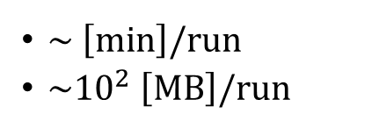
Statistical Framework (2/4): Gaussian Process Metamodeling
How to select important parameters to be inferred?
Global Sensitivity Analysis
27 initial parameters
12 influential parameters
How to approximate the input/output of the forward model?
Gaussian Process Metamodeling
$\sim \left[min\right]/run$
$\sim {10}^{2} \left[MB\right]/run$
Construct a metamodel for fast and efficient approximation
Metamodel: “a model of a model”

Slide 15
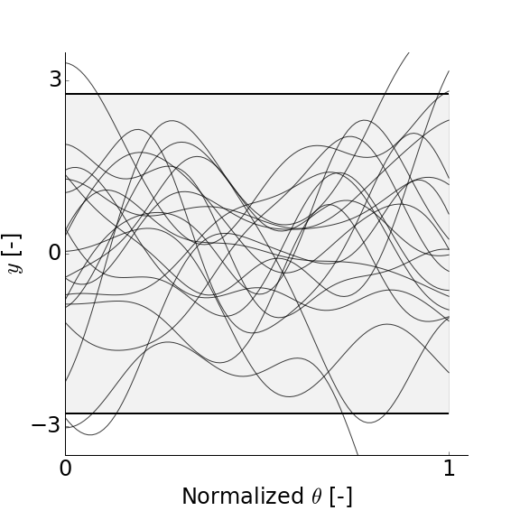
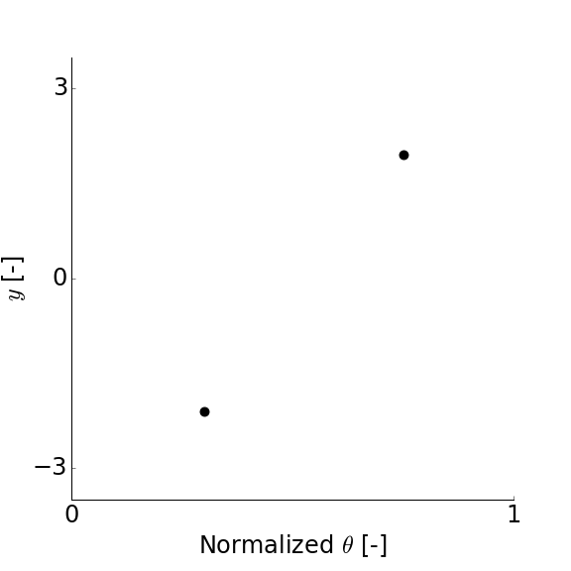






Gaussian Process (GP) Metamodel
Gaussian process is a Gaussian with continuous variates:$Y\left(x\right)∈ℝ;x∈ℝ^{D}$
Gaussian Process
process variance
$$Y(x)\sim GP\left(m(x), σ^{2}k\left(x,x^{∗}\right)\right)$$
Probability distribution of functions
mean function
correlation (kernel) function
$$k\left(x,x^{∗}\right)≡Cov\left[Y\left(x\right),Y(x^{∗})\right]$$
Application in Regression
Prior
Data
Posterior
$$x$$
$$x$$
$$x$$
Notes:
Main message is GP can be used to represent wide array of function using minimal number of parameters (or hyper parameters)

Slide 16




Constructing GP Metamodel: Training and Testing
Training Runs
Model fitting
$$\hat{f}(x)$$
Testing Runs
Design of Experiment
Testing
Prediction of testing runs by the metamodel
Notes:
We run TRACE to train the metamodel
Independently to that we also run TRACE to create testing data
We we test the metamodel performance we compare its prediction against the output real TRACE run

Slide 17
Constructing GP Metamodel: Training and Testing
Different factors involved in the construction of GP Metamodel
Training Runs
Model fitting
$$\hat{f}(x)$$
Different covariance kernels
Testing Runs
Design of Experiment
Testing
Different design schemes
Different training sample sizes
Prediction of testing runs by the metamodel
Notes:
We find out that the size of training sample is the main factor determining the predictive performance of the metamodel

Slide 18






Dealing with Multivariate Output: Principal Component Analysis
Output of the TRACE model of FEBA is highly multivariate.
Output Type | # of outputs $P=Δz×Δt$
Clad Temperature | $$8×{10}^{′}000={80}^{′}000$$
Pressure Drop | $$4×{10}^{′}000={40}^{′}000$$
Liquid Carryover | $$1×{10}^{′}000={10}^{′}000$$
Dimension reduction by Principal Component Analysis (PCA)
SVD
$$Y^{′}=U⋅S⋅V^{T}=W⋅V^{T}$$
Concatenate and centered outputs
Eigenvectors (principal components)
PC scores
$$y^{model}\left(x;z,t\right)={\overline{y}}^{model}\left(z,t\right)+\sum_{i=1}^{Q}{v_{i}\left(z,t\right)⋅w_{i}\left(x\right)}$$
Mean and 1st PC of clad temperature output
Prediction of multivariate output
the mean of output
$$Q_{TC}=7 \\ Q_{DP}=10 \\ Q_{CO}=5$$
PC scores, predicted by GP metamodel
Notes:
W is a scalar associated with a particular realization
V is eigenvector shared with all realizations
There are many eigenvectors but they are stacked with decreasing variance contribution
Note that Q is the number of retained principal components used to reconstruct the full output space and it is in this examples is typicaly less than 10.
And we simply need to construct metamodels predicting the scores of that selected PC.
The number was selected based on compromise between gained improvement and the difficulty to fit a GP metamodel.

Slide 19






Testing the Metamodel against Testing Samples
Metamodel predictive performance is assessed by comparison against large independent test data (i.e. actual TRACE runs)
$$Y_{TRACE,Test}−Y_{TRACE,Test}^{Q}$$
X-axis:
Dimension reduction error
Due to smaller $Q$to reconstruct the full output space
$$Y_{TRACE,Test}−Y_{GP,Test}^{Q}$$
$$Y_{TRACE,Test}−Y_{GP,Test}^{Q}$$
Y-axis:
Dimension reduction error and GP error
Due to (also) miss-prediction of PC scores
$$Y_{TRACE,Test}−Y_{TRACE,Test}^{Q}$$
Both are in terms of RMSE
Notes:
If the points are in line then the GP predicts perfectly the
If above the line then the GP metamodel mispredict
From left to right the error is due to Dimension reduction error

Slide 20




















Testing the Metamodel against Testing Samples ($N_{test}=5^{′}000$)
Metamodel predictive performance is acceptable for each output ${(N}_{train}=1^{′}920)$
Clad Temperature [K]
Pressure Drop [Pa]
Liquid Carryover [kg]
$$Y_{TRACE,Test}−Y_{GP,Test}^{Q}$$
$$Y_{TRACE,Test}−Y_{GP,Test}^{Q}$$
$$Y_{TRACE,Test}−Y_{GP,Test}^{Q}$$
$Y_{TRACE,Test}−Y_{TRACE,Test}^{Q}$
$Y_{TRACE,Test}−Y_{TRACE,Test}^{Q}$
$Y_{TRACE,Test}−Y_{TRACE,Test}^{Q}$
GP RMSE
$$22.4 [K]$$
$$77.95 [Pa]$$
$$0.27 [kg]$$
Testing Samples $σ$
$$254. [K]$$
$$9^{′}200 [Pa]$$
$$30.4 [kg]$$
$$(<9\%)$$
$$(<0.9\%)$$
$$(<0.9\%)$$
Notes:
The metamodel prediction is limited by the error due to dimension reduction
It also shows that we cannot go better than the error given by the metamodel.
In context it is find for the time being as the prior uncertainty gives a larger error (standard deviation)

Slide 21

Statistical Framework (3/4): Bayesian Calibration
How to select important parameters to be inferred?
Global Sensitivity Analysis
27 initial parameters
12 influential parameters
How to approximate the input/output of the forward model?
Gaussian Process Metamodeling
$\sim \left[min\right]/run$
$\sim {10}^{2} \left[MB\right]/run$
$\sim \left[s\right]/run$
$\sim {10}^{2} \left[MB\right]$
How to make the inference (quantification)?
Bayesian Calibration
Wide, independent prior uncertainties
Use experimental data to constrain the prior

Slide 22








Bayesian Calibration, Inverse Quantification: Uncertain (Inputs + Data) $⇒$Uncertain Inputs Updated
Experimental Data from SETF
$$D$$
Probability of observing data given parameters
Controllable inputs (w.r.t experiment)
$$x_{c}$$
Forward Model $$M:\left(x_{c},x_{m}\right)↦Y$$
Likelihood $$p\left(D|{x_{m},x}_{c} \right)$$
$$X_{m}|D,x_{c}$$
$$X_{m}$$
Uncertain model parameters (prior)
Uncertain model parameters (posterior)
Additional sources of uncertainty
$$p\left(x_{m} | D,x_{c}\right)=\frac{p\left(D|x_{m},x_{c}\right)×p\left(x_{m}\right)}{\int_{x_{m}}{p\left(D|x_{m},x_{c}\right)×p\left(x_{m}\right) dx_{m}}}$$
Bayes’ Theorem

Slide 23

Two Aspects of Bayesian Calibration: Formulation and Computation
Formulation
Computation
Experimental Data from SETF
$$D$$
Controllable inputs (w.r.t experiment)
$$x_{c}$$
Forward Model $$f:\left(x_{c},x_{m}\right)↦Y$$
Likelihood $$p\left(D|{x_{m},x}_{c} \right)$$
$$X_{m}|D,x_{c}$$
$$X_{m}$$
Uncertain model parameters (prior)
Uncertain model parameters (posterior)
Additional sources of uncertainty

Slide 24

Formulation of Bayesian Calibration: True, Experimental, and Predicted Values
Experimental data $y^{exp}$is a distorted observation of the true value
multi-dimensional data
measurement error,
$$y^{exp}\left(x_{c};z,t\right)=y^{true}\left(x_{c};z,t\right)+ϵ$$
Controlled variables (e.g., pressure, heat flux)
Model prediction $y^{M}$ is a imperfect prediction of the true value
Computer model
Model bias
Given $y^{exp}\left(x_{c};z,t\right)$, what is the range of consistent $x_{m}$?
$$y^{true}\left(x_{c};z,t\right)=y^{M}\left(x_{c},x_{m};z,t\right)+δ\left(x_{c};z,t\right)$$
Model parameters

Slide 25


Posterior Formulation: Normal Likelihood
given
GP
GP
Gaussian
Consider only data from one FEBA Test. No $x_{c}$ in formulation.
$$y^{exp}\left(z,t\right)=y^{M}\left(x_{m};z,t\right)+δ\left(z,t\right)+ε$$
unknown
Likelihood
Multiple sources of variance
$$p\left(y^{exp}|x_{m}\right)\sim N\left({\tilde{y}}^{M}+m_{b}, VΣ_{w}V^{T}+{V_{>P_{tr}}S}_{>P_{tr}}V_{>P_{tr}}^{T}+Σ_{b}+σ_{exp}^{2}I\right)$$
GP metamodel
Principal Comp. truncation
Model bias
measurement
No | Calibration Schemes
1 | With $δ,$all types of data
2 | $\text{With} δ,$against clad temperature (TC) data only
3 | $\text{With} δ\text{, }$against pressure drop (DP) data only
4 | $\text{With} δ,$against liquid carryover (CO) data only
5 | Without $δ,$ against all type of data
6 | $\text{With} δ,$excluding parameter $dffbVIHT$
6 calibration schemes were investigated
Notes:
We will go through the main results provided by the first 4 schems
Note that no xc means we only deal with the calibration of the 8 model parameters.

Slide 26


Computation of Bayesian Calibration
Uncertainty on $x_{m}$is fully specified by $p\left(x_{m} | \left\{y_{}^{exp}\right\}\right)$, the posterior pdf.
Bayes’ Theorem
Posterior
Likelihood
Prior
$$p\left(x_{m} | \left\{y_{}^{exp}\right\}\right)=\frac{p\left(\left\{y^{exp}\}\right|x_{m}\right)×p\left(x_{m}\right)}{\int_{x_{m}}{p\left(\left\{y^{exp}\}\right|x_{m}\right)×p\left(x_{m}\right) dx_{m}}}$$
How $p\left(x_{m} | \left\{y_{}^{exp}\right\}\right)$ is used:
Uncertainty propagation in an application setting (integration of a function under the posterior pdf)
Characterization of parameter uncertainty, e.g., moments (integration of the pdf over the parameter space)
Markov Chain Monte Carlo (MCMC) Simulation
Notes:
Note that posterior is a multidimensional probability density function
MH in a nutshell
We actually use Ensemble MCMC
$2×10^{6}$samples generated
Converge after $\frac{2}{5}$ of the way
How are we using p(xm) either to characterize xm (by its moments for instance) or used to integrate in the propagation fashion or

Slide 27

Constraining the Prior Uncertainty Range of the Model Parameters
gridHT
Prior uncertainty of the model parameter
iafbWHT
dffbWHT
Diagonal panels: univariate marginal PDFs
Off-diagonal panels: pairwise correlation plots
dffbVIHT
iafbIntDr
dffbIntDr
dffbWDr
tQuench
Notes:
Can the data and the calibration model can be used to constrain this prior?
Start by explaining how to read the figure: diagonal panels (univariate marginals pdf)
The vertical lines in the diagonal is the 95% credible interval
Off-diagonal panels: bivariate marginals
Explain column and row
Say that these are the 8 model parameters we are left with to be calibrated, I will mention it if necessary

Slide 28



Results: Considering pressure drop data to constrain the prior parameters range
gridHT
The posterior based on pressure drop data only
($≈10^{6}$samples)
iafbWHT
dffbWHT
Interfacial drag of the inverted annular flow regime (influential w.r.t to $ΔP$data)
dffbVIHT
iafbIntDr
dffbIntDr
dffbWDr
tQuench
Notes:
Pressure drop data manage to constrain some of the parameter mainly iafbIntDr

Slide 29


Results: Considering multiple types of data helps constrain the parameters uncertainty
gridHT
Spacer grid HTC enhancement
Wall HTC dispersed flow film boiling
The posterior based on all types of data
($≈10^{6}$samples)
iafbWHT
dffbWHT
Vapor-Interface HTC of the dispersed flow film boiling
dffbVIHT
Interfacial drag for the dispersed flow film boiling
iafbIntDr
dffbIntDr
dffbWDr
tQuench
Notes:
Data can help constrain the prior range of the model parameters. (only small part of the prior that is consistent with the calibration data)
The white, the white, the white (example gridHT)
But the posterior samples also exhibit correlation among the parameters. You can see this from the structure that can be observed in the posterior samples.
Illustrate why it makes sense that dffbVIHT and dffbIntDr are correlated from the physical point of view

Slide 30

Results: Posterior Samples are Correlated (i.e., a set of “collectively-fitted” values)
Uncertainty propagation on FEBA Test. No. 216 (the calibration data) based on 1’000 Monte Carlo samples.
Middle assembly
Top assembly
Clad Temperature [K]
Time [s]
Prior
Posterior, Independent
Posterior, Correlated
Exp. Data
Notes:
A set of “collectively-fitted” values which means that if we don’t consider them as a collection then the prediction would less match the calibration data itself.
If we only consider the univariate marginals (neglecting correlation) we obtain prediction that is less consistent with the calibration data.
Only if we consider the posterior samples jointly, that the prediction match the experimental data better.

Slide 31
Statistical Framework (4/4): Posterior Uncertainty Propagation
How to select important parameters to be inferred?
Global Sensitivity Analysis
27 initial parameters
12 influential parameters
How to approximate the input/output of the forward model?
Gaussian Process Metamodeling
$\sim \left[min\right]/run$
$\sim {10}^{2} \left[MB\right]/run$
$\sim \left[s\right]/run$
$\sim {10}^{2} \left[MB\right]$
How to make the inference (quantification)?
Bayesian Calibration
Wide, independent prior uncertainties
Narrower, correlated posterior uncertainties
Is the quantified uncertainty useful?
Wide prior prediction uncertainties
Propagate posterior uncertainties for different experimental conditions
Uncertainty Propagation

Slide 32







Comparing Different Calibration Results: Informativeness vs. Calibration Score
Two scores to summarize and compare results of uncertainty propagation using different posterior samples w.r.t the prior
Informativeness for output $y$
$${Inf}_{Y}=1−\frac{1}{2}\frac{UUB_{post.}−LUB_{post.}}{UUB_{prior}−LUB_{prior}}$$
LUB: Lower Uncertainty Bound
($2.5th$ prediction percentile)
UUB: Upper Uncertainty Bound
($97.5th$ prediction percentile)
$${Inf}_{Y}=0.5$$
Posterior prediction uncertainty is equal to that of the prior
$${Inf}_{Y}=1.0$$
No posterior prediction uncertainty
Notes:
Think of a posterior prediction is a source of information for output y and defined only in three values, the lower uncertainty bound, the upper uncertainty bound and the reference value
Informativeness tries to measure the width of posterior uncertainty band relative to that of the prior
Main message: large informativeness means narrower band

Slide 33







Comparing Different Calibration Results: Informativeness vs. Calibration Score
Two scores to summarize and compare results of uncertainty propagation using different posterior samples w.r.t the prior
Calibration Score for output $y$
$${Cal}_{Y}=π_{Y}\left(y_{exp}\right)$$
The height of the experimental data in the information triangle
$y_{ref}$: Reference value
($50th$ prediction percentile; median)
$${Cal}_{Y}=0.0$$
Experimental data falls outside the uncertainty band
$${Cal}_{Y}=1.0$$
Experimental data matches the reference value exactly
Notes:
Calibration measure the location of experimental data inside the so called “information” triangle
large calibration means closer to experimental data, while lower often means the band covers less experimental data

Slide 34



Posterior prediction uncertainties are narrower
Calibration Scheme
$$P_{sys}=4.1 \left[bar\right]$$
$$V_{inlet}=3.8 \left[cm.s^{−1}\right]$$
All Parameters, Correlated
Calibration [-]
All Parameters, Independent
Informativeness [-]
Notes:
Begin by explaining how to read the figure
Vertical line
Horizontal line (Less “calibrated” here means cover less experimental data points)
The location of the points
The effect of not considering correlation
Because calibration score is highly penalizing. But the point of the measure is to check whether there is pattern across experimental conditions.

Slide 35

Posterior prediction uncertainties are narrower, insignificant effects of experimental conditions
Calibration Scheme
$$P_{sys}=4.1 \left[bar\right]$$
$$V_{inlet}=3.8 \left[cm.s^{−1}\right]$$
All Parameters, Correlated
Calibration [-]
All Parameters, Independent
Informativeness [-]
Calibration [-]
Informativeness [-]
Notes:
There is no strong pattern of discrepancy
Yes the calibration score falls for all, but it is because fail to cover the experimental data by the band is highly penalizing. What we are interested in this comparison, especially to indicate whether the overfitting occurs severely is to look at the different prior and posterior calibration and compare with the results of Test 216. If the difference is larger than it would slightly overfit. There is no significant overfitting based on this difference.

Slide 36

Removing highly correlated parameter and keeping it at its prior range give a compromise
Calibration Scheme
$$P_{sys}=4.1 \left[bar\right]$$
$$V_{inlet}=3.8 \left[cm.s^{−1}\right]$$
All Parameters, Correlated
Calibration [-]
All Parameters, Independent
Excl. dffbVIHT, Correlated
Excl. dffbVIHT, Independent
Informativeness [-]
Notes:
Yet there is reason to be prudent when it comes to correlation. (univariate marginal) Parameter uncertainty can be wide (indicating no overfitting) but the correlation can cause such overfitting nevertheless.
Why the triangle is now there? Investigation on the influential and strongly correlated parameter
The location of the triangle in the graph
Mention that now the difference between the two triangle is really minor meaning the correlation becomes less influential

Slide 37

Removing highly correlated parameter and keeping it at its prior range give a compromise
Calibration Scheme
$$P_{sys}=4.1 \left[bar\right]$$
$$V_{inlet}=3.8 \left[cm.s^{−1}\right]$$
All Parameters, Correlated
Calibration [-]
All Parameters, Independent
Excl. dffbVIHT, Correlated
Excl. dffbVIHT, Independent
Informativeness [-]
Calibration [-]
Informativeness [-]
Notes:
The same pattern across different experimental condition

Slide 38
Conclusion
Motivation:
Uncertainty in physical model parameters are often derived solely based on expert-judgment and on a particular calibration data
Objectives:
Given data from a separate effect test facility, develop a methodology to systematically quantify the uncertainty of the parameters in the TRACE code
Contribution:
Consolidation, implementation, and application of tools based on statistical framework for quantifying the physical model parameters in the TRACE code
Global Sensitivity Analysis
Gaussian Process Metamodeling
Bayesian Calibration
Uncertainty Propagation

Slide 39
Contributions
Developed Tools:
trace-simexp Python3 command line utilities for conducting simulation experiment of a TRACE model of SETF
gsa-module Python3 module implementing various design of experiments and global sensitivity analysis methods (e.g. Morris and Sobol’ indices est.)
Applied Tools to a TRACE Model (demonstration of applicability):
fda R module to conduct functional data analysis
DiceKriging R module to train Gaussian process metamodel
Ensemble MCMC samplers (emcee & rgw) Application of MCMC samplers to calibrate code model parameters

Slide 40
Contributions
Publications and other contributions:
4 International conference papers
1 journal article
2 submissions to the OECD/NEA PREMIUM benchmark Phase 4
2 contributions to the OECD/NEA PREMIUM reports and 1 PSI technical report
Two additional publications outside the scope the thesis are co-authored using the developed tools

Slide 41
Contributions: Demonstration of the Methodology on the FEBA TRACE Model
How to select important parameters to be inferred?
Global Sensitivity Analysis
27 initial parameters
12 influential parameters
How to approximate the input/output of the forward model?
Gaussian Process Metamodeling
$\sim \left[min\right]/run$
$\sim {10}^{2} \left[MB\right]/run$
$\sim \left[s\right]/run$
$\sim {10}^{2} \left[MB\right]$
How to make the inference (quantification)?
Bayesian Calibration
Wide, independent prior uncertainties
Narrower, correlated posterior uncertainties
Is the quantified uncertainty useful?
Wide prior prediction uncertainties
Narrower posterior prediction uncertainties for all exp. conditions
Uncertainty Propagation
Notes:
And through the thesis itself it is demonstrated that
FEBA TRACE model is a relatively small and simple model, but it is by no means a toy model. It illustrates a typical analysis of calibrating TRACE model parameters based on SETF

Slide 42


Future Work
Global Sensitivity Analysis
Need to establish a connection between GSA and identifiability.
Non-sensitive parameters are non-identifiable
Highly sensitivity parameters are identifiable
Unclear for parameters with intermediate sensitivity
Gaussian Process Metamodeling
Better prediction
Worse prediction
PCA performed worse for reconstructing output with discontinuity. Need alternative dimension reduction method.
Notes:
As for GP metamodeling, we are lucky because the error incurred by such imperfection is smaller than the overall initial variation induced by the prior uncertainty. But if the uncertainty becomes more precise, we need more accurate metamodeling approach, at least in dealing with output containing discontinuity. Basically the difference between 9 and 0.9% previously explained.

Slide 43

Future Works
Bayesian Calibration
218
214
220
Calibration was only done based on one dataset. Error structure might differ
Sequential calibration against other SETF remains open question
FEBA
RBHT
ACHILLES
223
216
222
Uncertainty Propagation
How to summarize generic correlation structure of the posterior useful for downstream analysis? (Copula?)
Notes:
We calibrate only with one (and we did verify against different test data), but its performance depends on the assume error structure that derived only with the aforementioned calibration data. We need to simultaneously consider
We don’t often consider correlation among model parameters, but calibration will result in a correlated posterior. Consistent propagation requires this information to be carried.
What is the repercussion in practice when we have to consider such correlation in the model parameters.

Slide 44
Wir schaffen Wissen – heute für morgen
Thank you for your attention.
My sincere gratitude to:
Prof. A. Pautz
Mr. O. Zerkak
Dr. G. Perret
Mr. Ph. Jacquemoud
Dr. M. Hursin
Dr. D. Rochman
Mr. H. Ferroukhi
Other members of STARS
The jury members:
Dr. J. Baccou
Prof. R. Houdré
Prof. B. Sudret
Dr. W. Zwermann
Additional acknowledgments:
Swiss Federal Nuclear Safety Inspectorate (ENSI)
Swiss Federal Office of Energy (BFE)

